Slide 1
Demo-1
Team A3 Sergei, Jannes, Sander, Pascal, Vis de Boer & de Blauwe Trekker

Slide 2
RFID

Slide 3
Raspberry Pi

Slide 4
Wireless

Slide 5
Scheme

Slide 6

TestFlight
iOS-only
iOS 15+ iPhone 6s/SE1 en hoger
Download TestFlight
Download Mechielsen demo app
Notes:
Ook beschikbaar op iPad, Apple Watch, Mac, Apple TV, Vision Pro en iPod Touch 7

Slide 7
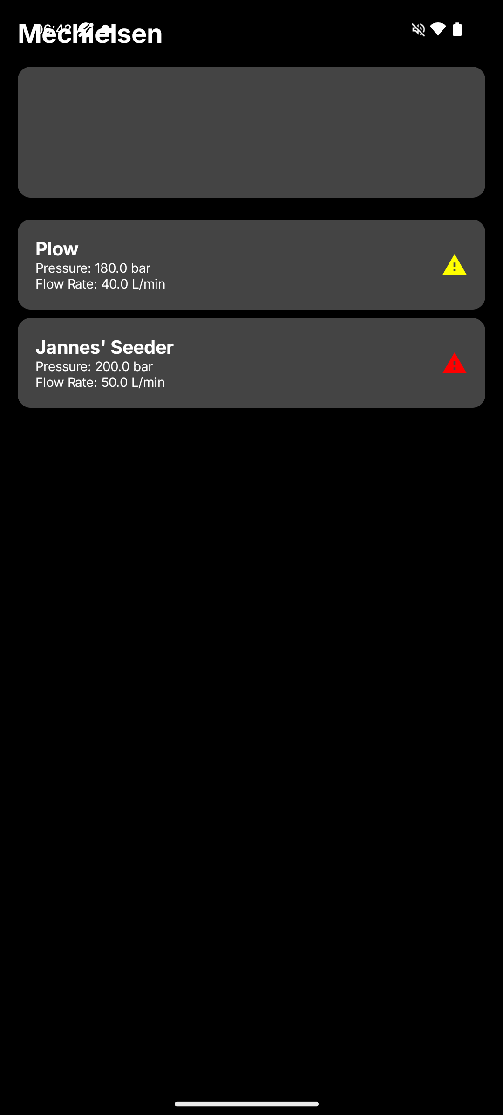
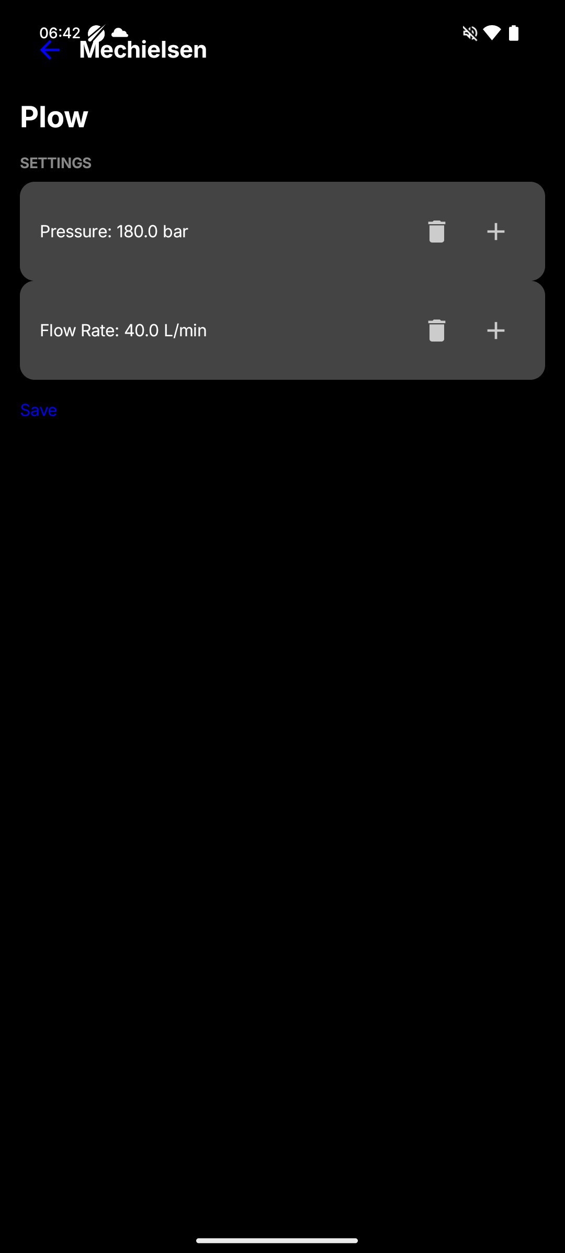
Android

Slide 8
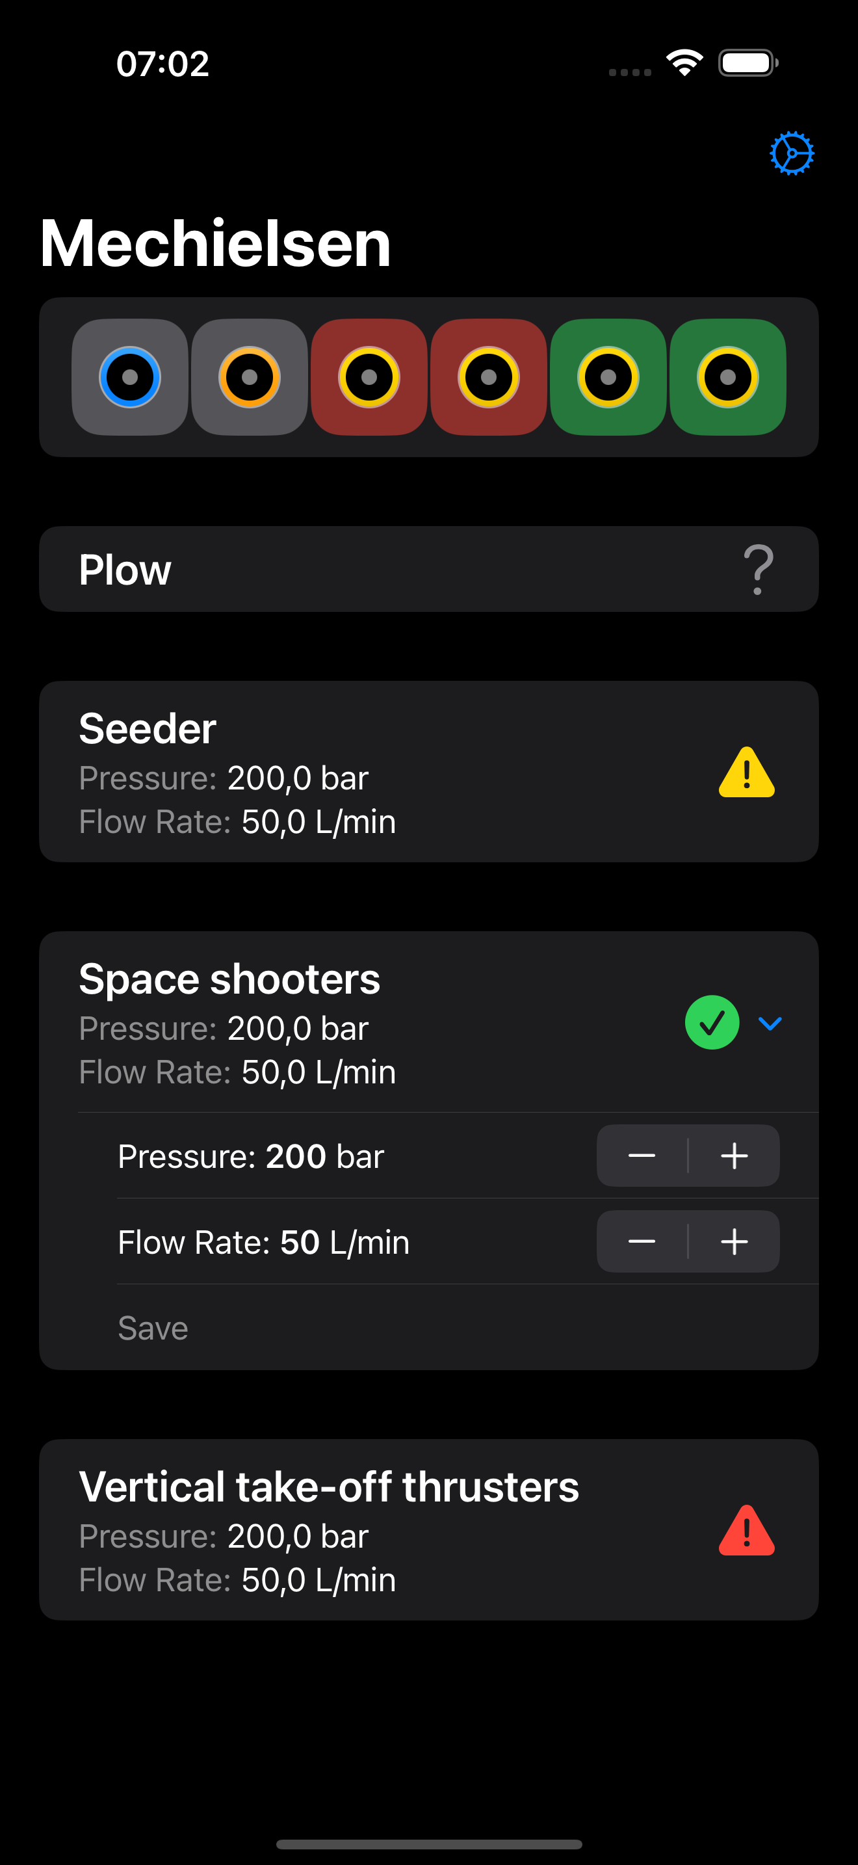
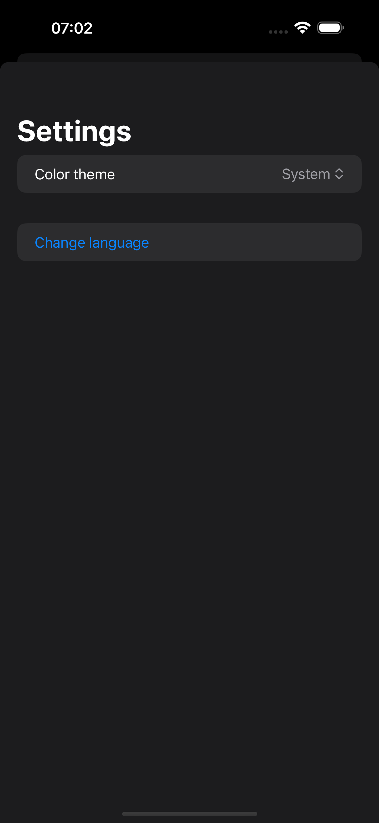
iOS

